Slide 1
2021 Regional Fall Workshop

Slide 2
2021-22
Regional Officer Team
Region 1
President- Emily Oliver
VP Communications – Ellie Youngblood
VP Public Relations – Lilly P’pool
VP Records- Aubrey Morse
VP Finance- Jenna Visingardi
VP Membership- Savannah Garnett

Slide 3
DECA Motto:
DECA prepares emerging leaders and entrepreneurs in marketing, finance, hospitality and management in high schools and colleges around the globe.

Slide 4
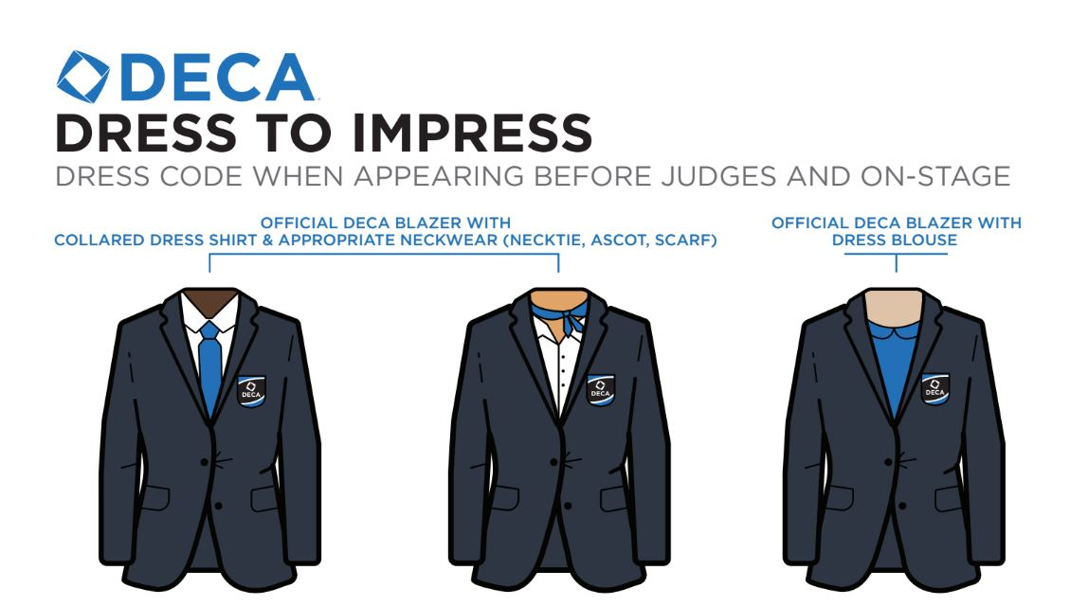
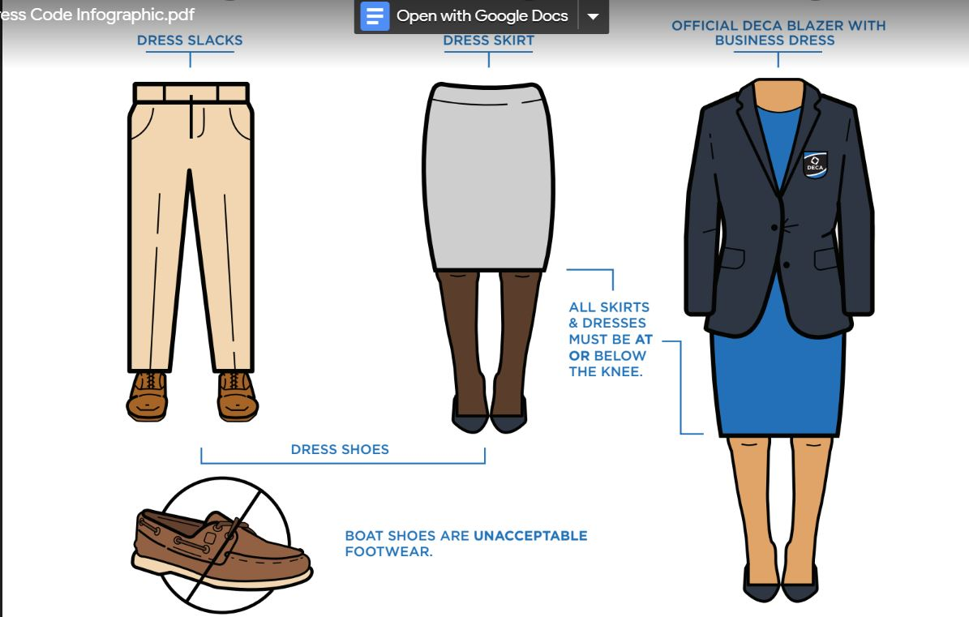

Slide 5
MALES
NO shorts
Wear shirts tucked in
FEMALES
Must wear Scarf/Ascot with collared shirt
No leggings
Boots are not appropriate

Slide 6
MALES:
Shirts have collars (no t-shirts)
Wear dress shoes
Wear a tie for competition (blazers are optional)
SUCCESS
FEMALES:
A business professional pantsuit is a great choice!
Dress shoes
Simple makeup and jewelry
SUCCESS

Slide 7
MALES:
Polo-style shirts are not for competition
Jeans are not acceptable for competition
FEMALES:
Skirts must be knee-length or below
Must wear scarf/ascot with collared shirt

Slide 8
MALES:
Blazer, Dress Shirt, Dress Pants, Tie, and Dress Shoes = SUCCESS
FEMALES:
Blazer, Dress Top, Dress Pants, Scarf and Dress Shoes = SUCCESS

Slide 9
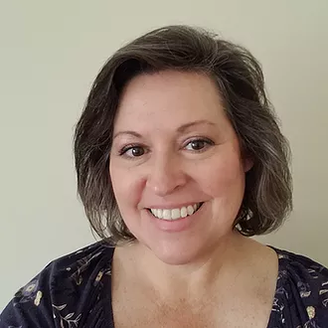
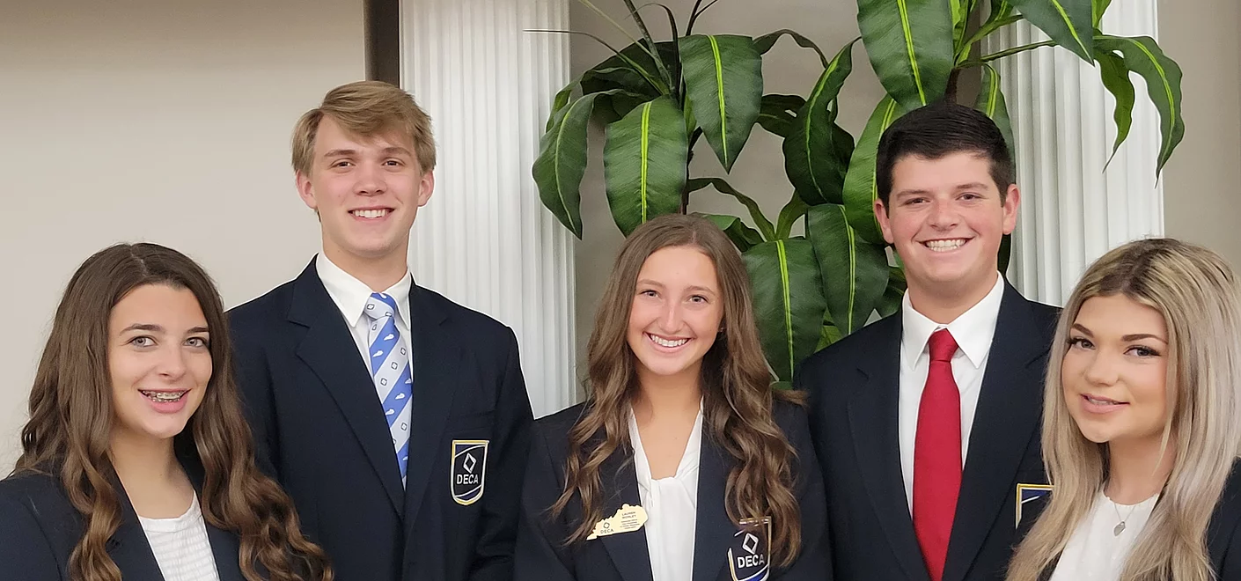
Kentucky Leaders
Lisa Oakes,
Kentucky State Advisor
DECA State Officer Team

Slide 10
2021-2022 State Officers
Lauren Worley
President
Pulaski County High School
Parker Sellers
Vice President of Membership
Pulaski Co. High School
Ivey Redd
Vice President of Finance
Trigg Co. High School
Lilly P’pool
Vice President of Public Relations
Trigg Co. High School
Brooklyn Williams
Vice President of Communications
Graves Co. HS

Slide 11
Follow us on Instagram!
@kydecaregion1
Post pictures on Insta stories and tag us!

Slide 12
Region 1 DECA Career Development Conference (CDC)
Registration Deadlines
Registration - December 15, 2021
Projects - January 5, 2022 Competition Day @ MSU
Wednesday, January 19, 2022

Slide 13
Kentucky SCDC
State Career Development Conference Feb. 27-
March 1, 2022
Louisville, KY
Your Kentucky DECA officers are planning a great state conference

Slide 14
DECA ICDC—Atlanta, GA
April 23-April 26, 2022

Slide 15
Make all travel requests now if possible Save the Date

Slide 16
Attention. . .Attention. . .Attention
New Guideline
All Written projects and any events with a written summary must but be uploaded by January 5 by 6pm CST.
7 days to fix--Must upload any changes to projects moving to SCDC within 7 days of your Regional Conference-January 26 (Region 1)
Penalty points --if late--10 points/day
Don’t forget--Statement of Assurances must be included

Slide 17
On-Line Registration and Testing
December 1 Electronic Registration Opens in Blue Panda
$25 students, $50 Advisors
Local registration fee may added which will increase cost/varies by school
December 15 Initial Registration Ends-
Input as many students as you can in all events (easier to delete than add students)
No entries in Team Decision Making, Professional Selling, or Written Events after December 15 (Wed) You may change team members but no additional events may be registered
All Written projects and components must be uploaded by January 5 along with any substitutions
No Late Registrations will be accepted.

Slide 18
On Line Testing approximate dates
December 15 Proctor name and email submitted by this date
January 3-7 On-line testing instructions sent out if proctor information has been received.
January 10-14 On line testing window

Slide 19
On Line Testing –Who will Test early??? Only test students registered in these events All Professional Selling Events Team Decision Making Events All Integrated Marketing Campaigns Do not allow any other areas to be tested prior to conference (System may not block out others)

Slide 20
Pre-Conference Testing
See DECA Guide to see what Career Cluster your exam covers.
Check out new Exam Blueprint in the DECA Guide

Slide 21
DECA Video Challenges & OnLine Events
It is not too late to participate in the video challenges or OnLine Competitions
Go to DECA.Org for details

Slide 22
DECA Direct Online source with a wealth of competitive event advice and helpful hints.
Decadirect.org

Slide 23
Outstanding Chapter Member
of the Year.
Regional level: Each chapter submits one name selected by advisor or chapter and are announced to receive award
State level: Regional OCM can submit a video resume of their DECA activities and accomplishments.
Committee reviews and narrows to one per region.
5 Regional OCM featured during Opening Session of SCDC.
Each chapter submits one vote
KY DECA Outstanding Chapter Member of the Year
will be announced at Recognition Night.

Slide 24
Diamond in the Rough Award
Award submitted directly to KY State Advisor
Chapter Advisors submit one per chapter
students they feel deserve recognition
for extraordinary efforts
and/or encouragement to others in DECA
Recognized at SCDC during Recognition Night

Slide 25
Membership Campaigns DECA.Org
KY DECA goal 1,500 members
Each One Reach One
November 15 –Initial Membership due—keep adding until competition. Professional members are important.
November is DECA Month
All requirements for membership rewards due December 1
Promotional Campaign
Membership Campaign
Community Service Campaign
Advocacy Campaign - March 1

